Slide 1
Hotel Reservation System
Developed by:DhanaLakshmi.Y

Slide 2
Abstraction:
Objective : To design and implement a console-based Multi-Hotel Reservation System using a modular, layered Java architecture.
Description : The project allows users to select a specific hotel and perform full CRUD operations (Create, Read, Update, Delete) on room reservations, ensuring data is filtered by the chosen hotel context.
Features : Features include user authentication, dynamic hotel selection, reservation management tied to a unique hotel_id, and layered separation of concerns (Controller, Service, DAO).

Slide 3
Technology Stack
Language : Java (JDK 8+)
Database : MySQL
DataAccess : JDBC (Java Database Connectivity)
Build Path : Apache Maven
UnitTest : JUnit
Security : BasicHashing

Slide 4
Project Structure
Controller Layer : Handles user input.
Service Layer : Contains business logic.
DAO Layer : Interacts with the database.
Model Layer : Represents entities (Hotel,Reservation,User).
Testing LayerUnit : Testing & Reliability,Separate structure (src/test/java) for automated testing.
Flow : User → Controller → Service → DAO → Database

Slide 5
System Architecture :The 3-Tier Model
Layer | Responsibility | Key Classes
1. Presentation / Controller | User I/O, Application Flow, Main Loop. | HotelReservationSystem.java
2. Business / Service | Business Logic, Data Validation, State Management (e.g., checking room number range). | AuthService.java, ReservationService.java
3. Data Access / DAO | Database Queries (SQL), Connection Management, Data Mapping. | ReservationDAO.java, HotelDAO.java

Slide 6
Core Functionality and Features
  User Authentication: Secure access control via username and password stored in the users table.
  Multi-Hotel Context: The system is designed to manage bookings for multiple, separate hotels by enforcing a hotel_id filter on all reservation operation
  Comprehensive Reservation Management: Full CRUD (Create, Read, Update, Delete) support for reservations.
  Query-Based Retrieval: Ability to retrieve specific booking details (like Room Number) using combined criteria (reservation_id and guest_name).

Slide 7
ER Diagram (Text View)
Type : One-to-Many (1:M)
Cardinality : One hotel can have many reservations.
Defining Key : Reservations.Hotel_id references Hotels.hotel_id
Hotels—(1) has(Many) Reservations.

Slide 8
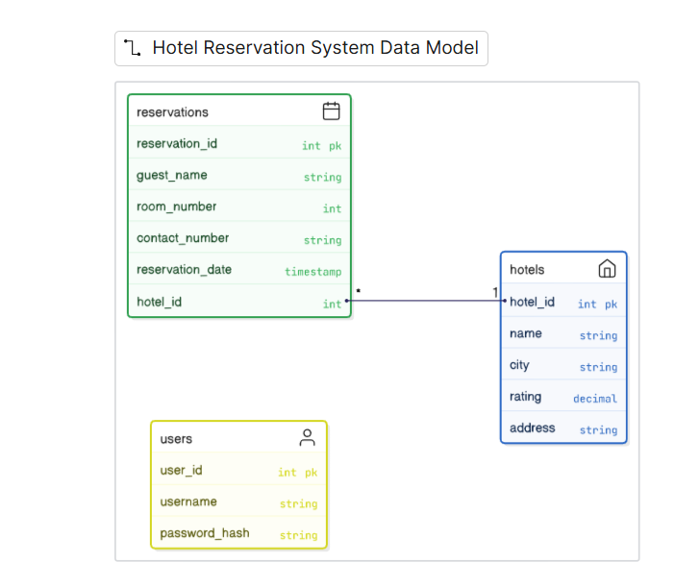
ER Diagram

Slide 9
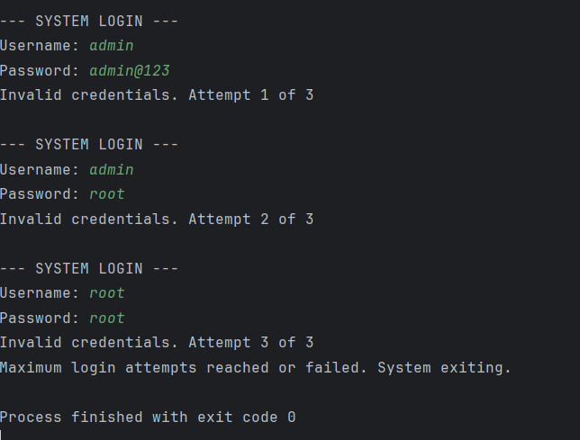
OutPut:

Slide 10
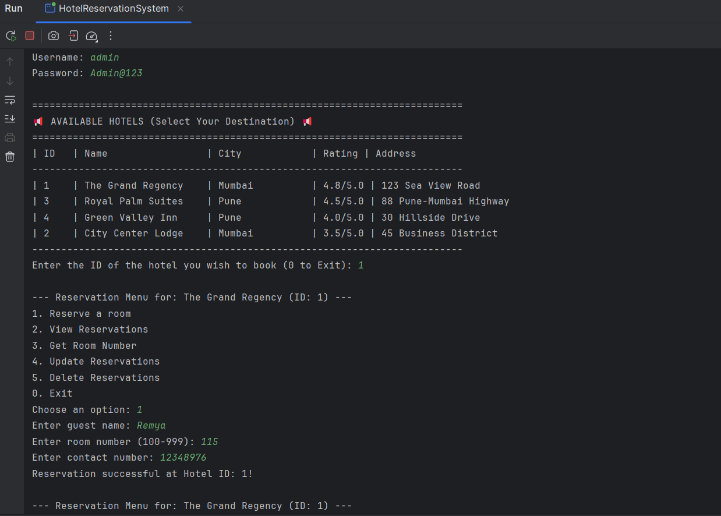

Slide 11
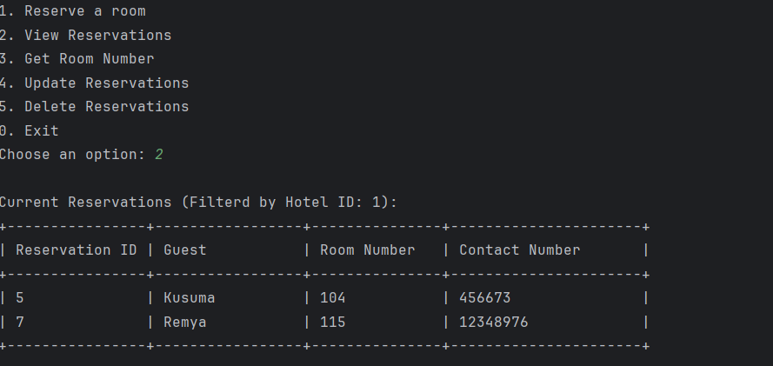

Slide 12
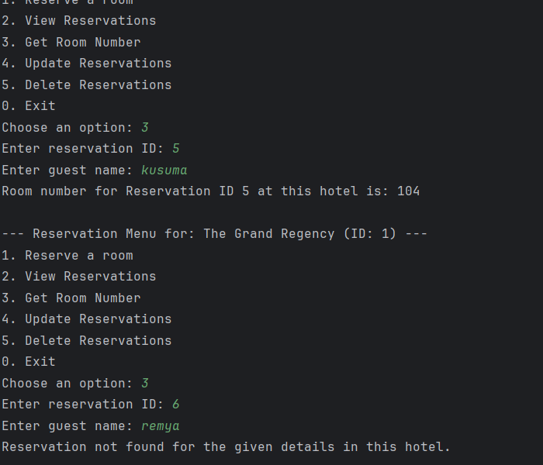

Slide 13
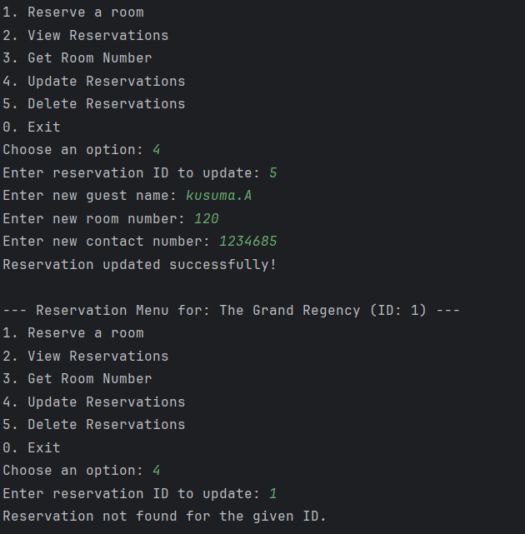
OutPuts
Update option→

Slide 14
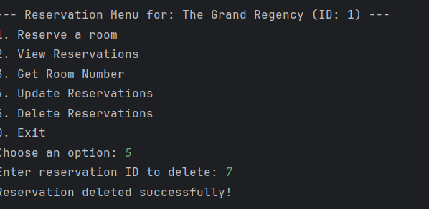
Output:
Delete the reservation→

Slide 15
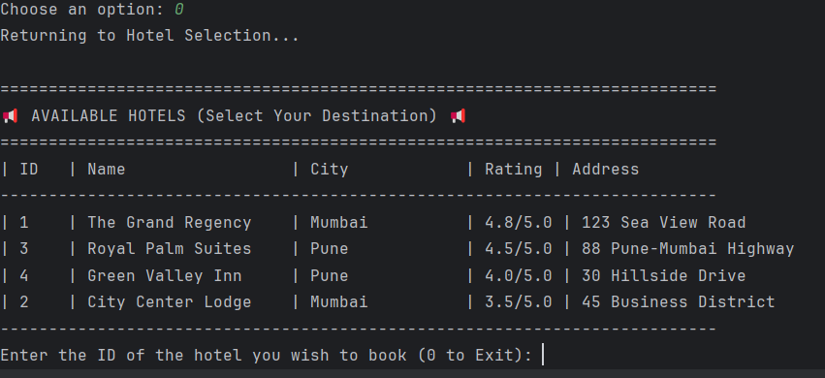
Exit→
We select exit option then it goes to show the available hotels after that the process is same.

Slide 16
Conclusion:
The project demonstrates core Java and JDBC concepts, focusing on secure and persistent data management with MySQL.
Successfully follows the Layered Design Pattern (DAO-Service-Controller) for modularity, maintenance, and clear separation of concerns.
Implements real-world problem-solving techniques, including robust exception handling and database transaction management.

